Slide 1
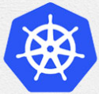
1 Kubernetes on Ubuntu 22.04
Peter H. Chen

Slide 2
1 Kubernetes on Ubuntu 22.04
https://www.linuxtechi.com/install-kubernetes-on-ubuntu-22-04/
Kubernetes on Ubuntu 22.04
Kubernetes is free open-source container orchestration tool, it also known as k8s.
Kubernetes is or automated deployment, scaling, and management of containerized application.
Kubernetes cluster consists of worker nodes on which application is deployed and
master nodes which are used to manage worker nodes and pods in the cluster.
System Requirement:
Ubuntu 22.04, min 2GB RAM, min 2 CPU, 20 GB disk space
sudo user with admin right, Internet connectivity on each node.

Slide 3
1.1 Setup hostname and hosts file

Slide 4
1.1 Setup hostname and hosts file
https://www.linuxtechi.com/install-kubernetes-on-ubuntu-22-04/
Setup hostname
Master Node: 192.168.1.8, kmaster
Worker Node 1: 192.168.1.2, knode1
Worker Node 2: 192.168.1.4, knode2
On Master Node:
> sudo hostnamectl set-hostname "kmaster"
> exec bash
On Worker Node 1:
> sudo hostnamectl set-hostname "knode1"
> exec bash

Slide 5
1.1 Setup hostname and hosts file
https://www.linuxtechi.com/install-kubernetes-on-ubuntu-22-04/
Setup hosts file
Master Node: 192.168.1.8, kmaster
Worker Node 1: 192.168.1.2, knode1
Worker Node 2: 192.168.1.4, knode2
On Master Node:
> vi /etc/hosts
>> 192.168.1.8 kmaster
>>192.168.1.2 knode1
>> 192.168.1.4 knode2
On Worker Node 1:
> vi /etc/hosts
>> 192.168.1.8 kmaster
>>192.168.1.2 knode1
>> 192.168.1.4 knode2

Slide 6
1.2 Disable Swap and Add Kernel Settings

Slide 7
1.2 Disable Swap and Add Kernel Settings
https://www.linuxtechi.com/install-kubernetes-on-ubuntu-22-04/
Disable Swap
Run below swapoff and sed command to disable swap.
Make sure to run below commands to all master and worker nodes
Turn off memory/file swap mode
> sudo swapoff -a
> sudo sed -i '/ swap / s/^\(.*\)$/#\1/g' /etc/fstab
Note:
The above command is explained as below:
1. Use below “sed” command to inplace (-i) to replace the matched pattern (/ swap /) in the file /etc/fstab.
2. Find pattern (/ swap /) and substitute (s) from start (^) to end ($), match any characters (.*) between start (^) and end ($). Replace the all (g, globally) matched “ swap ….” into “#1” (Comment #1).

Slide 8
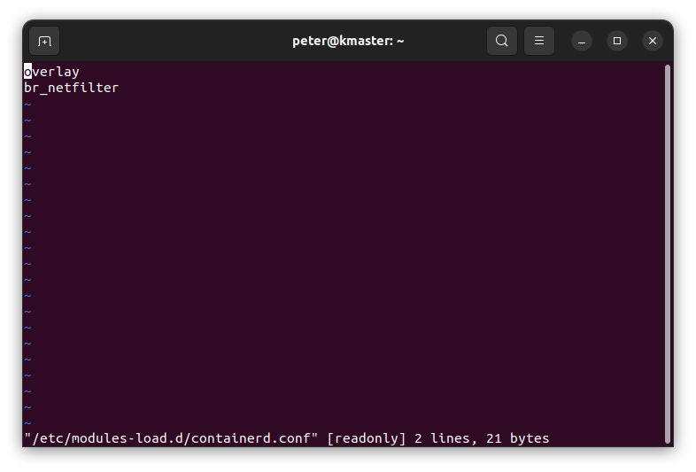
1.2 Disable Swap and Add Kernel Settings
https://www.linuxtechi.com/install-kubernetes-on-ubuntu-22-04/
Load Kernel Modules
Load the following kernel modules on all the nodes:
> sudo tee /etc/modules-load.d/containerd.conf <<EOF
Overlay
br_netfilter
EOF
> sudo modprobe overlay
> sudo modprobe br_netfilter
Note:
The above command is explained as below:
1. Use “tee” command to edit /etc/sysctl.d/kubernetes.conf file and “EOF” for end of file marker.
2. Put two kernel parameters “Overlay…” into the /etc/modules-load.d/containerd.conf file
3. Exit and save file with EOF marker
4. Add module overlay to kernel
5. Add br_netfilter to kernel.

Slide 9
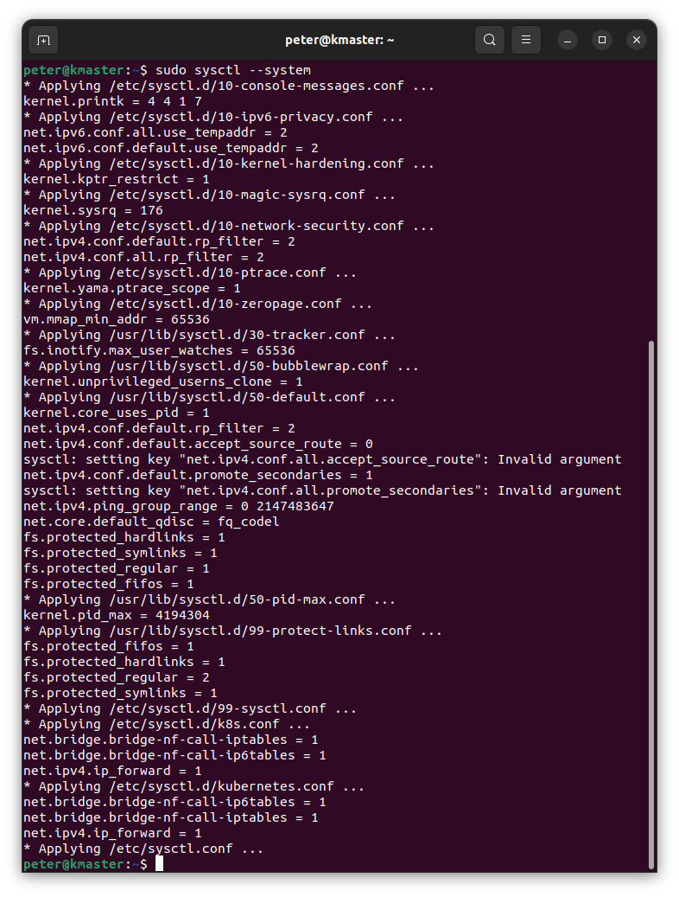
1.2 Disable Swap and Add Kernel Settings
https://www.linuxtechi.com/install-kubernetes-on-ubuntu-22-04/
Reload Kernel Modules and Kernel Settings
We then reload the above kernel module and kernel settings.

Slide 10
1.3 Install Containerd Run Time

Slide 11
1.3 Install Containerd Run Time
https://www.linuxtechi.com/install-kubernetes-on-ubuntu-22-04/
Install Containerd
We are using containerd run time for our Kubernetes cluster.
So, to install containerd, first install its dependencies.
> sudo apt install -y curl gnupg2 software-properties-common apt-transport-https ca-certificates

Slide 12
1.3 Install Containerd Run Time
https://www.linuxtechi.com/install-kubernetes-on-ubuntu-22-04/
Enable Docker Repository
Enable Docker Repository
> sudo curl -fsSL https://download.docker.com/linux/ubuntu/gpg | sudo gpg --dearmour -o /etc/apt/trusted.gpg.d/docker.gpg
> sudo add-apt-repository "deb [arch=amd64] https://download.docker.com/linux/ubuntu $(lsb_release -cs) stable"

Slide 13
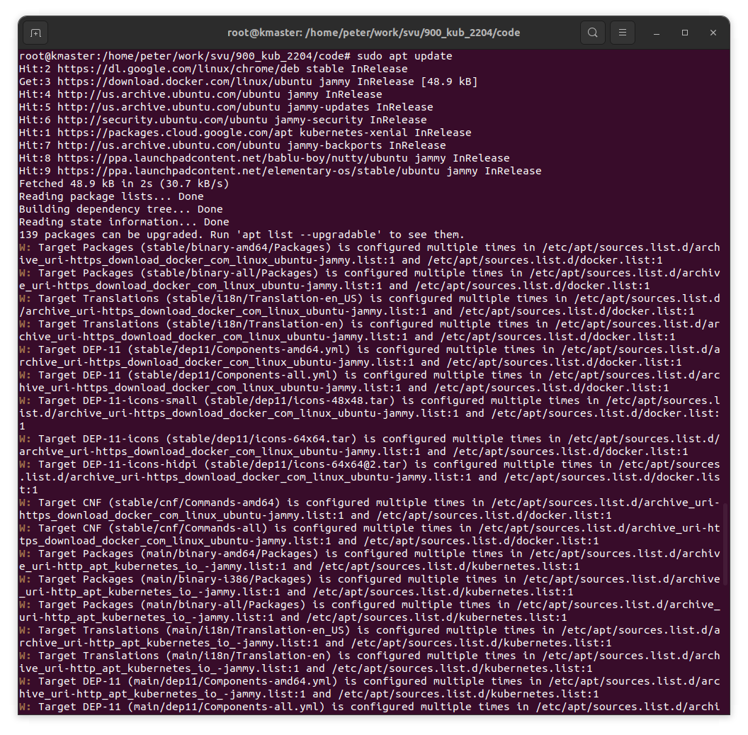
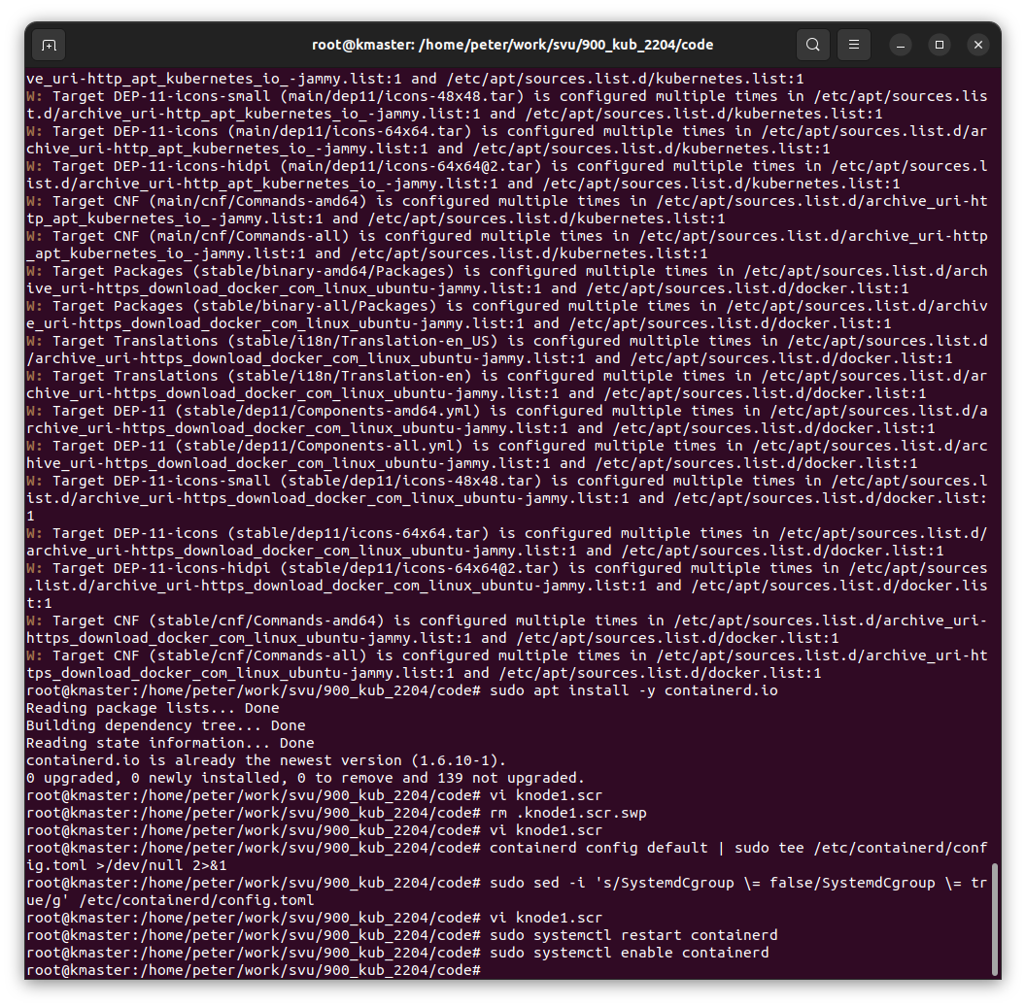
1.3 Install Containerd Run Time
https://www.linuxtechi.com/install-kubernetes-on-ubuntu-22-04/
Install Containerd
Now, run following apt command to install containerd:
> sudo apt update
> sudo apt install -y containerd.io

Slide 14
1.3 Install Containerd Run Time
https://www.linuxtechi.com/install-kubernetes-on-ubuntu-22-04/
Configure Containerd for cgroup
Configure containerd so that it starts using systemd as cgroup.
> containerd config default | sudo tee /etc/containerd/config.toml >/dev/null 2>&1
> sudo sed -i 's/SystemdCgroup \= false/SystemdCgroup \= true/g' /etc/containerd/config.toml

Slide 15
1.3 Install Containerd Run Time
https://www.linuxtechi.com/install-kubernetes-on-ubuntu-22-04/
Restart and Enable Containerd Service
# Restart and enable containerd service
> sudo systemctl restart containerd
> sudo systemctl enable containerd

Slide 16
1.4 Add apt Repository for Kubernetes

Slide 17
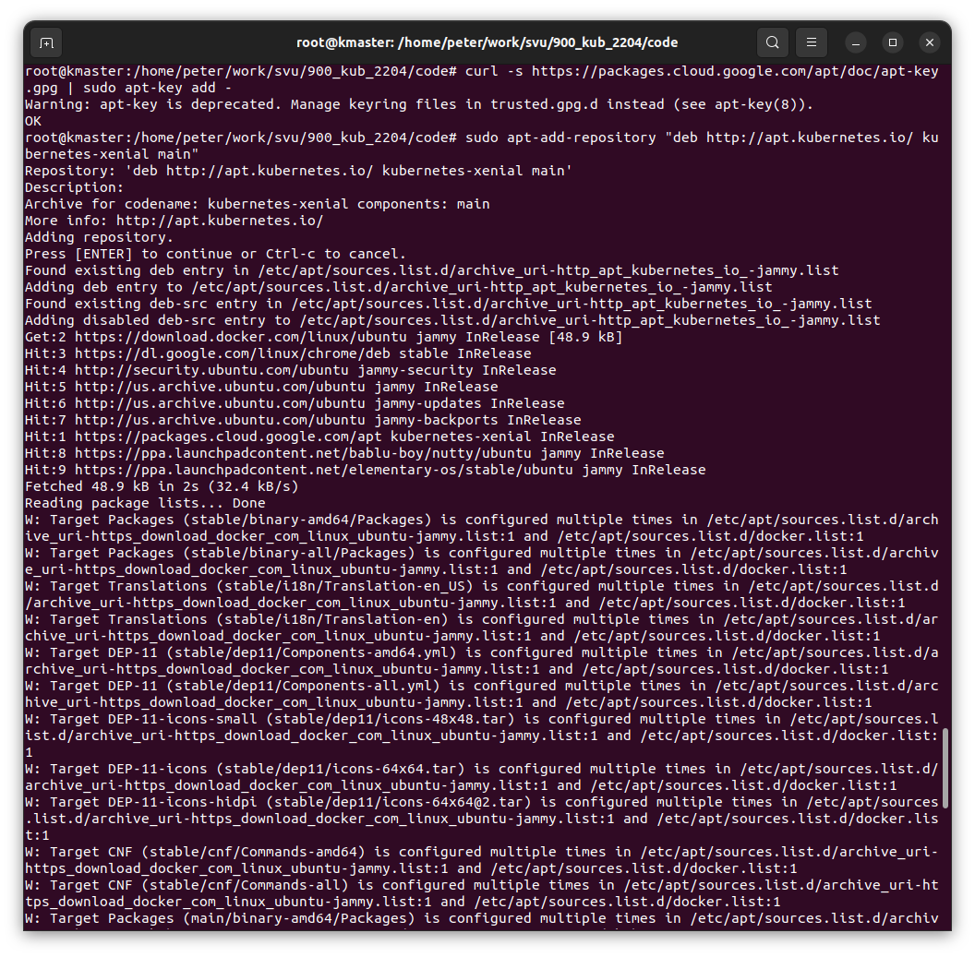
1.4 Add apt Repository for Kubernetes
https://www.linuxtechi.com/install-kubernetes-on-ubuntu-22-04/
Add apt Repository for Kubernetes
Execute following commands to add apt repository for Kubernetes:
> curl -s https://packages.cloud.google.com/apt/doc/apt-key.gpg | sudo apt-key add -
> sudo apt-add-repository "deb http://apt.kubernetes.io/ kubernetes-xenial main"
Note:
At time of writing this guide, Xenial is the latest Kubernetes repository but when repository is available for Ubuntu 22.04 (Jammy Jellyfish) then you need replace xenial word with ‘jammy’ in ‘apt-add-repository’ command.

Slide 18
1.5 Install Kubernetes Components: Kubectl, Kubeadm, Kubelet

Slide 19
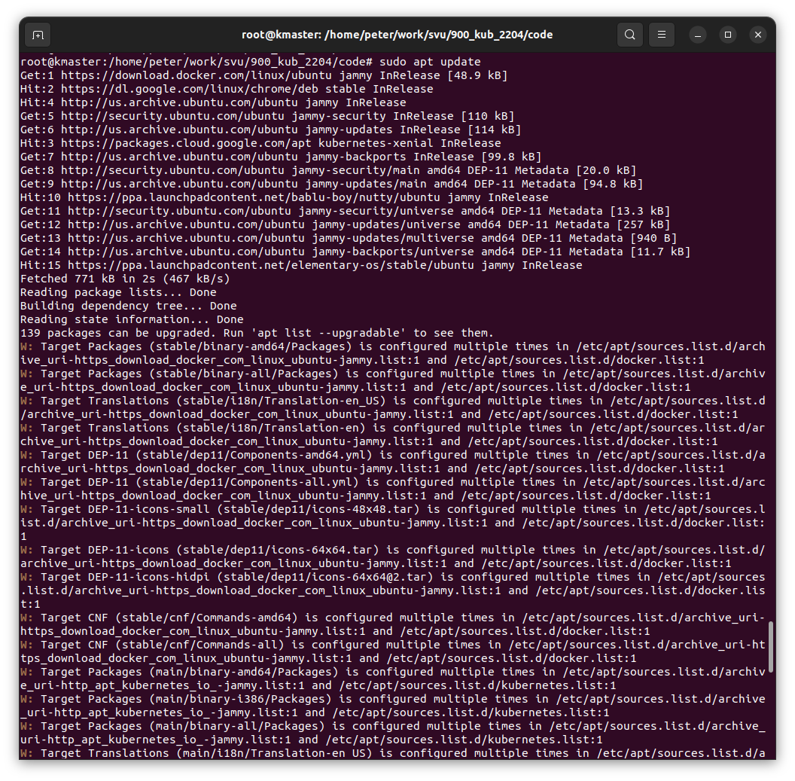
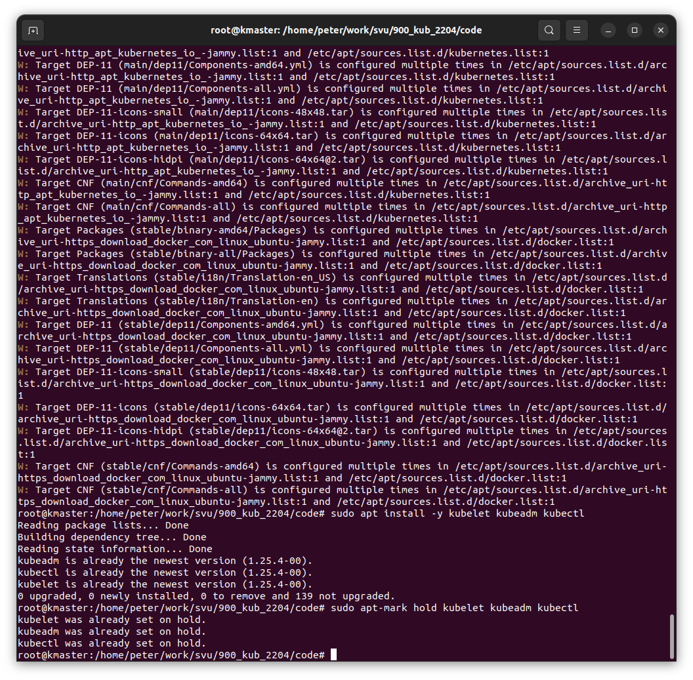
1.5 Install Kubernetes Components: Kubectl, Kubeadm, Kubelet
https://www.linuxtechi.com/install-kubernetes-on-ubuntu-22-04/
Install Kubernetes Components: Kubectl, Kubeadm, Kubelet
Install Kubernetes components like kubectl, kubelet and Kubeadm utility on all the nodes. Run following set of commands,
> sudo apt update
> sudo apt install -y kubelet kubeadm kubectl
> sudo apt-mark hold kubelet kubeadm kubectl

Slide 20
1.6 Initialize Kubernetes Cluster with Kubeadm Command

Slide 21
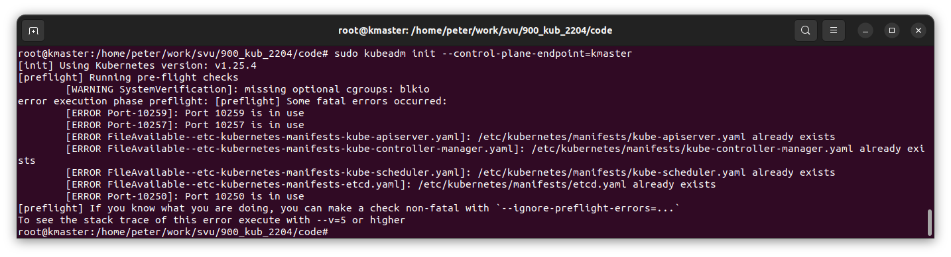
1.6 Initialize Kubernetes Cluster with Kubeadm Command
https://www.linuxtechi.com/install-kubernetes-on-ubuntu-22-04/
Initialize Kubernetes Cluster with Kubeadm Command (Master Node Only)
Now, we are all set to initialize Kubernetes cluster.
Run the following Kubeadm command from the master node only.
> sudo kubeadm init –control-plane-endpoint=kmaster
Error Message: Port in use: …
Note:
The above command needs to specify “cidr=…”

Slide 22
1.6 Initialize Kubernetes Cluster with Kubeadm Command
https://www.linuxtechi.com/install-kubernetes-on-ubuntu-22-04/
Initialize Kubernetes Cluster with Kubeadm Command (Master Node Only)
Error Message:
[init] Using Kubernetes version: v1.25.4
[preflight] Running pre-flight checks
[WARNING SystemVerification]: missing optional cgroups: blkio
error execution phase preflight: [preflight] Some fatal errors occurred:
[ERROR Port-10259]: Port 10259 is in use
[ERROR Port-10257]: Port 10257 is in use
[ERROR FileAvailable--etc-kubernetes-manifests-kube-apiserver.yaml]: /etc/kubernetes/manifests/kube-apiserver.yaml already exists
[ERROR FileAvailable--etc-kubernetes-manifests-kube-controller-manager.yaml]: /etc/kubernetes/manifests/kube-controller-manager.yaml already exists
[ERROR FileAvailable--etc-kubernetes-manifests-kube-scheduler.yaml]: /etc/kubernetes/manifests/kube-scheduler.yaml already exists
[ERROR FileAvailable--etc-kubernetes-manifests-etcd.yaml]: /etc/kubernetes/manifests/etcd.yaml already exists
[ERROR Port-10250]: Port 10250 is in use
[preflight] If you know what you are doing, you can make a check non-fatal with `--ignore-preflight-errors=...`
Error Solution:
https://github.com/kubernetes/kubeadm/issues/339
> netstat -lnp | grep 1025
> kill <PID>

Slide 23
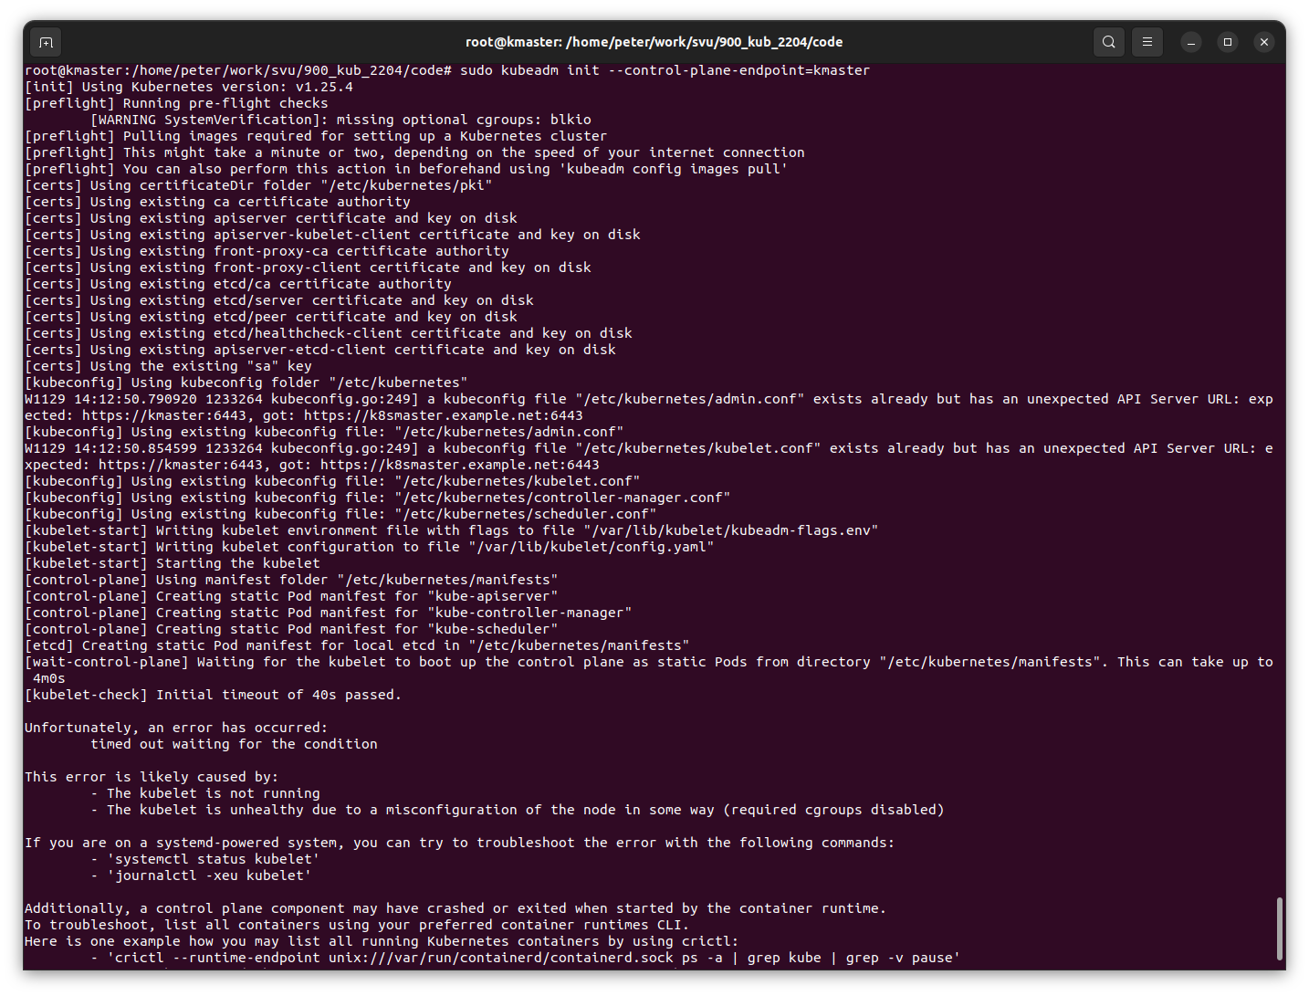
1.6 Initialize Kubernetes Cluster with Kubeadm Command
https://www.linuxtechi.com/install-kubernetes-on-ubuntu-22-04/
Initialize Kubernetes Cluster with Kubeadm Command (Master Node Only)
Error message:
Initial timeout for 40s
This is kubelet is not running or not health.

Slide 24
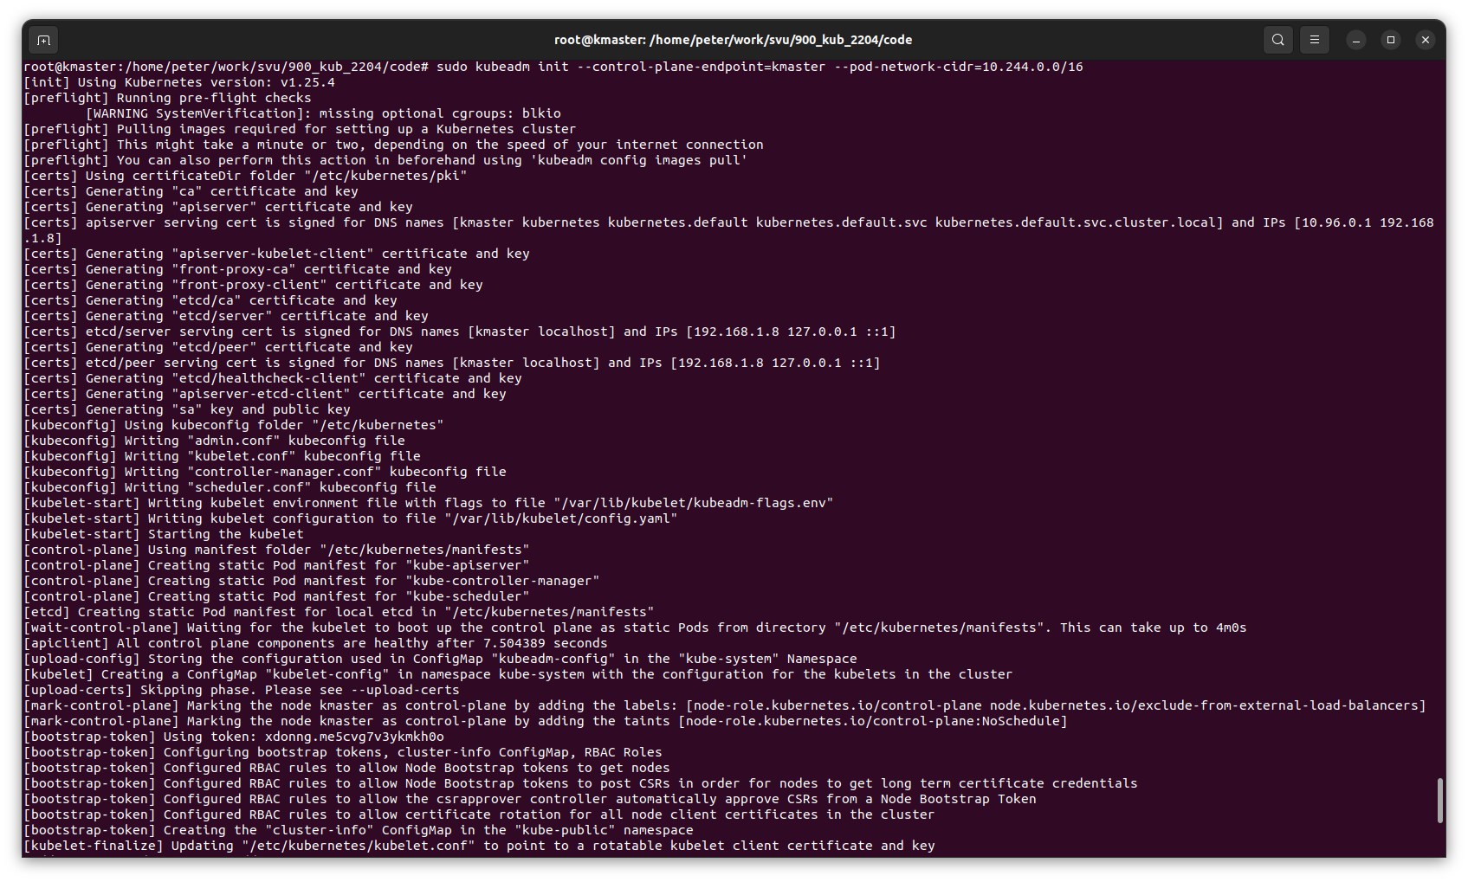
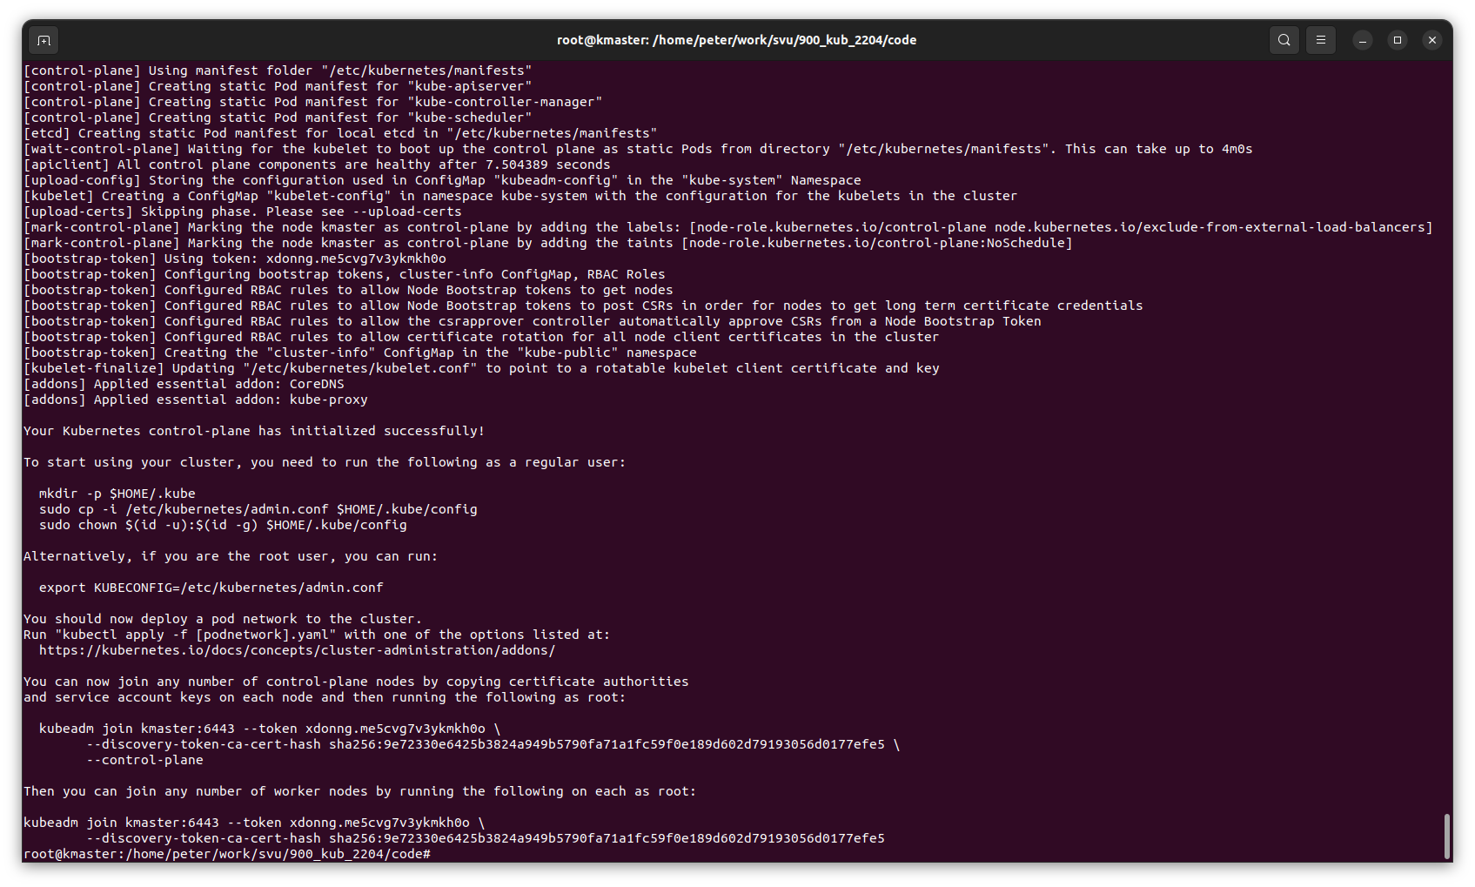
1.6 Initialize Kubernetes Cluster with Kubeadm Command
https://stackoverflow.com/questions/57648829/how-to-fix-timeout-at-waiting-for-the-kubelet-to-boot-up-the-control-plane-as-st
Initialize Kubernetes Cluster with Kubeadm Command (Master Node Only)
https://stackoverflow.com/questions/57648829/how-to-fix-timeout-at-waiting-for-the-kubelet-to-boot-up-the-control-plane-as-st
> sudo kubeadm init --control-plane-endpoint=kmaster --pod-network-cidr=10.244.0.0/16
Note:
I add “--pod-network-cidr=10.244.0.0/16” to fix the kubelet time out problem from kubelet.

Slide 25
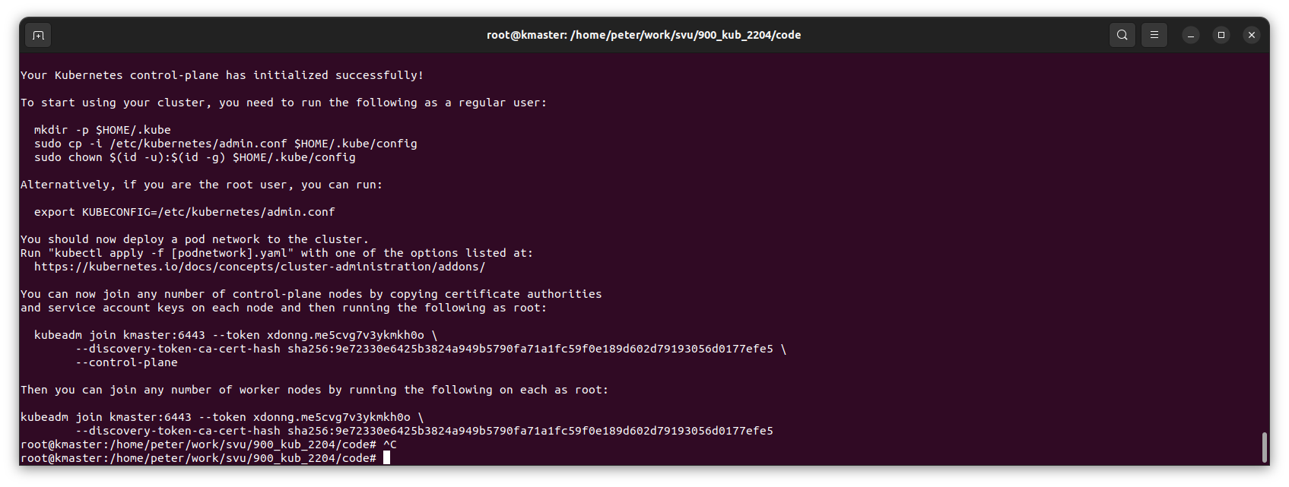
1.6 Initialize Kubernetes Cluster with Kubeadm Command
https://www.linuxtechi.com/install-kubernetes-on-ubuntu-22-04/
Output of the command
As the output above confirms that control-plane has been initialize successfully.
In output also we are getting set of commands for interacting the cluster and also the command for worker node to join the cluster.

Slide 26
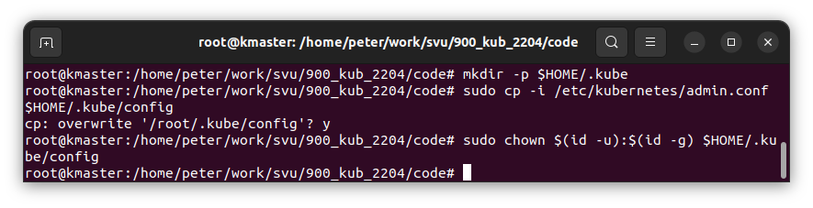
1.6 Initialize Kubernetes Cluster with Kubeadm Command
https://www.linuxtechi.com/install-kubernetes-on-ubuntu-22-04/
Run Output Command
So, to start interacting with cluster, run following commands from the master node,
> mkdir -p $HOME/.kube
> sudo cp -i /etc/kubernetes/admin.conf $HOME/.kube/config
> sudo chown $(id -u):$(id -g) $HOME/.kube/config

Slide 27
1.6 Initialize Kubernetes Cluster with Kubeadm Command
https://www.linuxtechi.com/install-kubernetes-on-ubuntu-22-04/
View Output Command
In the output, we can see:
Alternatively, if you are the root user, you can run:
> export KUBECONFIG=/etc/kubernetes/admin.conf
You should now deploy a pod network to the cluster.
Run "kubectl apply -f [podnetwork].yaml" with one of the options listed at:
https://kubernetes.io/docs/concepts/cluster-administration/addons/
You can now join any number of control-plane nodes by copying certificate authorities and service account keys on each node and then running the following as root:
> kubeadm join kmaster:6443 --token xdonng.me5cvg7v3ykmkh0o \
--discovery-token-ca-cert-hash \
sha256:9e72330e6425b3824a949b5790fa71a1fc59f0e189d602d79193056d0177efe5 \
--control-plane
Then you can join any number of worker nodes by running the following on each as root:
> kubeadm join kmaster:6443 --token xdonng.me5cvg7v3ykmkh0o \
--discovery-token-ca-cert-hash \
sha256:9e72330e6425b3824a949b5790fa71a1fc59f0e189d602d79193056d0177efe5

Slide 28
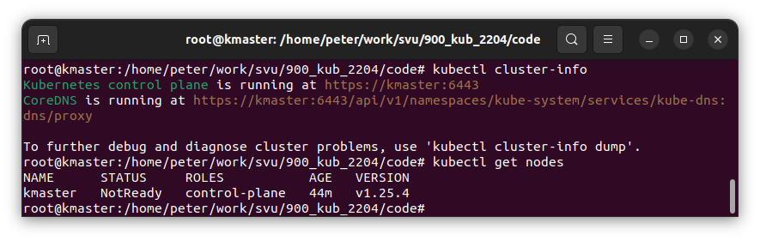
1.6 Initialize Kubernetes Cluster with Kubeadm Command
https://www.linuxtechi.com/install-kubernetes-on-ubuntu-22-04/
Run Output Command
Now, try to run following kubectl commands to view cluster and node status
> kubectl cluster-info
> kubectl get nodes
Now, the master node is running.
We need to join the worker nodes (knode1 and knode2)

Slide 29
1.7 Join Worker Node(s): Knode1

Slide 30
1.7 Join Worker Node(s): knode1
https://www.linuxtechi.com/install-kubernetes-on-ubuntu-22-04/
Join Worker Nodes
Join both the worker nodes to the cluster, command is already there is output, just copy paste on the worker nodes:
You can now join any number of control-plane nodes by copying certificate authorities and service account keys on each node and then running the following as root:
> kubeadm join kmaster:6443 --token xdonng.me5cvg7v3ykmkh0o \
--discovery-token-ca-cert-hash \
sha256:9e72330e6425b3824a949b5790fa71a1fc59f0e189d602d79193056d0177efe5 \
--control-plane
Then you can join any number of worker nodes by running the following on each as root:
> kubeadm join kmaster:6443 --token xdonng.me5cvg7v3ykmkh0o \
--discovery-token-ca-cert-hash \
sha256:9e72330e6425b3824a949b5790fa71a1fc59f0e189d602d79193056d0177efe5

Slide 31
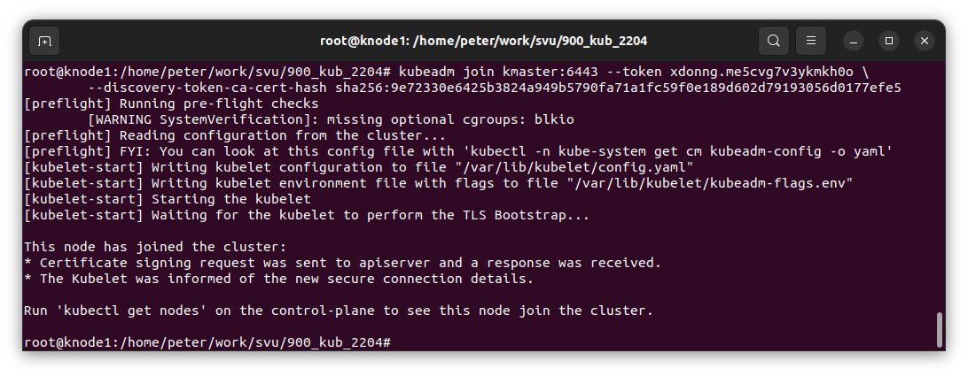
1.7 Join Worker Node(s): knode1
https://www.linuxtechi.com/install-kubernetes-on-ubuntu-22-04/
Join Worker Nodes
The first command is failed to join.
I used the second command to join.
Then you can join any number of worker nodes by running the following on each as root:
> kubeadm join kmaster:6443 --token xdonng.me5cvg7v3ykmkh0o \
--discovery-token-ca-cert-hash \
sha256:9e72330e6425b3824a949b5790fa71a1fc59f0e189d602d79193056d0177efe5

Slide 32
1.8 Check Join Node from Kmaster

Slide 33
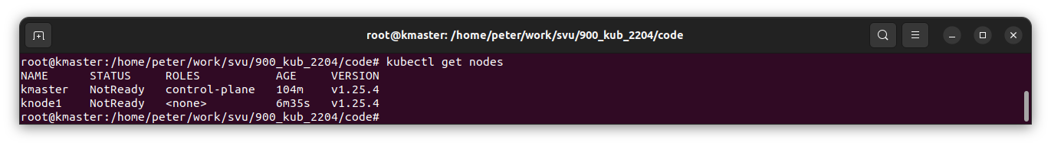
1.8 Check Join Node from Kmaster
https://www.linuxtechi.com/install-kubernetes-on-ubuntu-22-04/
Check Join Node from Kmaster
Now, we can check both nodes in the kmaster
> kubectl get nodes

Slide 34
1.9 Install Calico Pod Network Add-On

Slide 35
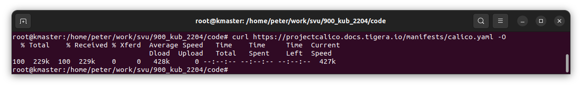
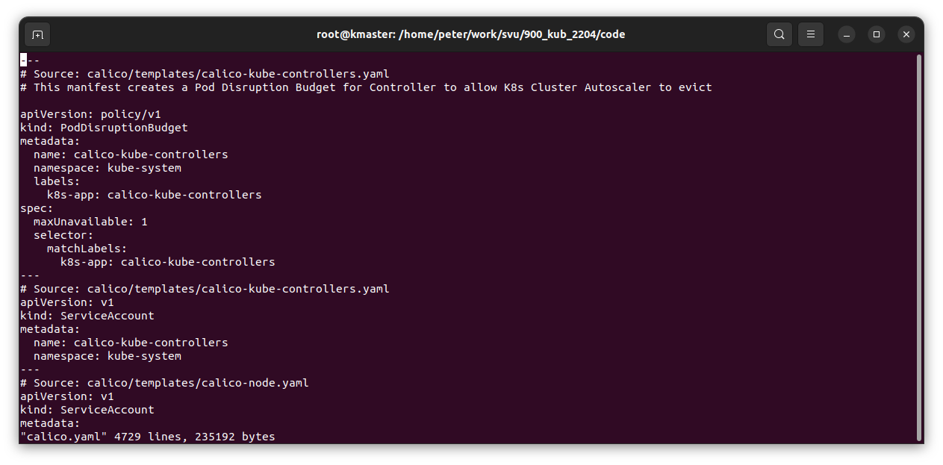
1.9 Install Calico Pod Network Add-On
https://www.linuxtechi.com/install-kubernetes-on-ubuntu-22-04/
Install Calico Pod Network Add-On
Run following curl and kubectl command to install Calico network plugin from the master node:
> curl https://projectcalico.docs.tigera.io/manifests/calico.yaml -O
> vi calico.yaml

Slide 36
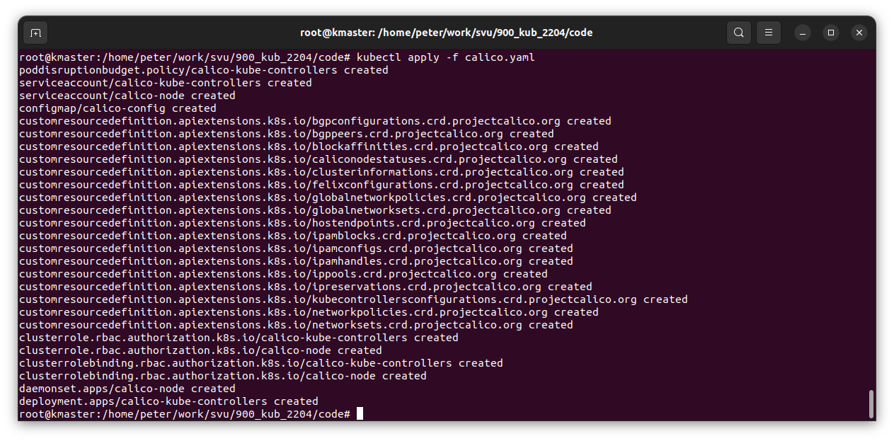
1.9 Install Calico Pod Network Add-On
https://www.linuxtechi.com/install-kubernetes-on-ubuntu-22-04/
Install Calico Pod Network Add-On
> kubectl apply -f calico.yaml

Slide 37
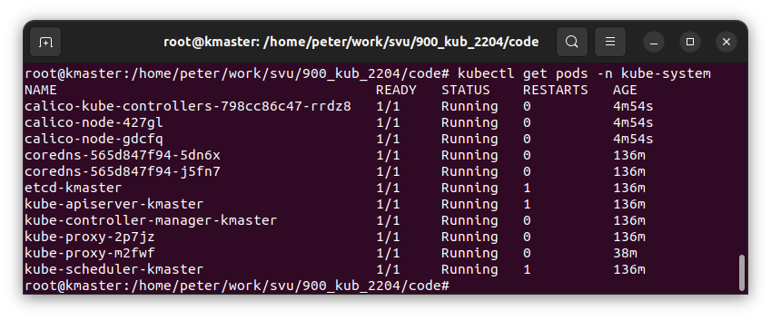
1.9 Verify Status of Pods in Kube-system
https://www.linuxtechi.com/install-kubernetes-on-ubuntu-22-04/
Verify status of Pods in kube-system
Verify the status of pods in kube-system namespace,
> kubectl get pods -n kube-system

Slide 38
1.10 Test Kubernetes Insallation

Slide 39
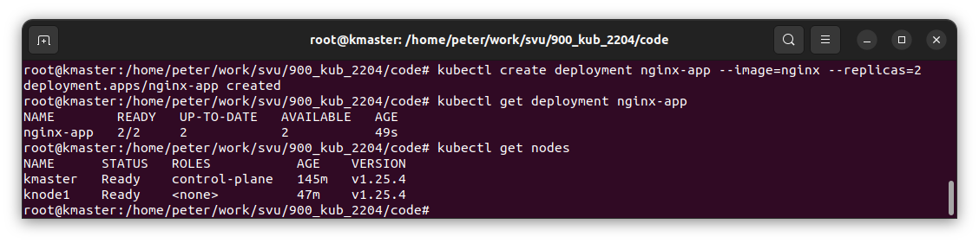
1.10 Test Kubernetes Insallation
https://www.linuxtechi.com/install-kubernetes-on-ubuntu-22-04/
Deploy nginx and replicas
To test Kubernetes installation, let’s try to deploy nginx based application and try to access it.
> kubectl create deployment nginx-app --image=nginx --replicas=2
Check the status of nginx-app deployment
> kubectl get deployment nginx-app
>> NAME READY UP-TO-DATE AVAILABLE AGE
>> nginx-app 2/2 2 2 68s

Slide 40
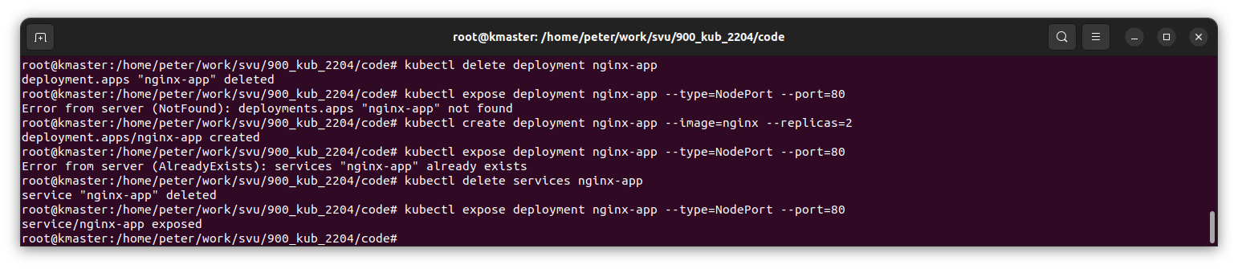
1.10 Test Kubernetes Insallation
https://www.linuxtechi.com/install-kubernetes-on-ubuntu-22-04/
Expose Deployment to NodePort
Expose the deployment as NodePort
> kubectl expose deployment nginx-app --type=NodePort –port=80
>> service/nginx-app exposed
Other commands: delete deployment/service
> kubectl delete deployment nginx-app
>> deployment.app “nginx-app” deleted
> kubectl delete services nginx-app
>> service “nginx-app” deleted

Slide 41
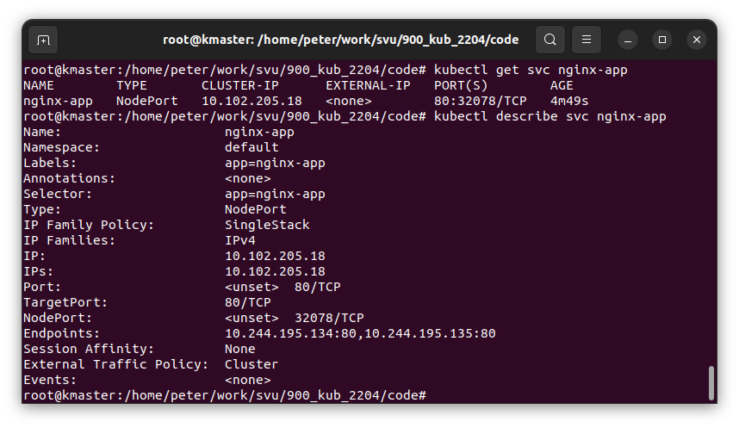
1.10 Test Kubernetes Insallation
https://www.linuxtechi.com/install-kubernetes-on-ubuntu-22-04/
Service Status
Run following commands to view service status:
> kubectl get svc nginx-app
> kubectl describe svc nginx-app
>> We can see the NodePort is “32078”

Slide 42
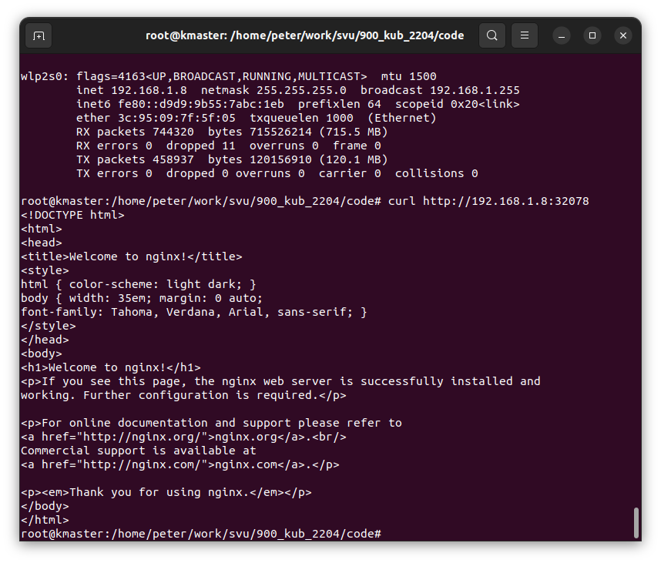
1.10 Test Kubernetes Insallation
https://www.linuxtechi.com/install-kubernetes-on-ubuntu-22-04/
Access Application in Node by IP Address:Port
Use following command to access nginx based application,
> curl http://<woker-node-ip-addres>:32078
In our case
>curl 192.168.1.8:32078
We can access the the nginx based application on the right.

Slide 43
End

